Slide 1
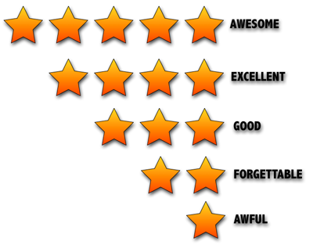
Rating Prediction Project:-
Dharambir Mahto

Slide 2
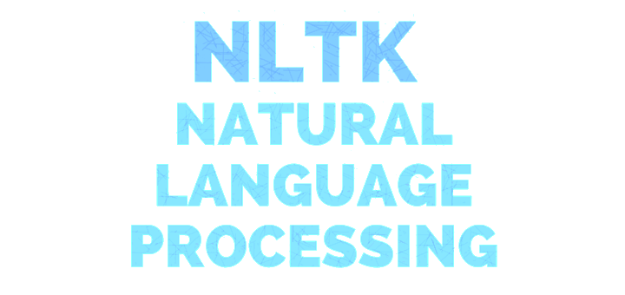

Slide 3
NLTK is a leading platform for building Python programs to work with human language data. It provides easy-to-use interfaces to over 50 corpora and lexical resources such as Word Net, along with a suite of text processing libraries for classification, tokenization, stemming, tagging, parsing, and semantic reasoning, wrappers for industrial-strength NLP libraries

Slide 4
Problem Statement and Understanding.
The rise in E — commerce, has brought a significant rise in the importance of customer reviews. There are hundreds of review sites online and massive amounts of reviews for every product. Customers have changed their way of shopping and according to a recent survey, 70 percent of customers say that they use rating filters to filter out low rated items in their searches.
The ability to successfully decide whether a review will be helpful to other customers and thus give the product more exposure is vital to companies that support these reviews, companies like Flipkart, Amazon and Yelp!.

Slide 5

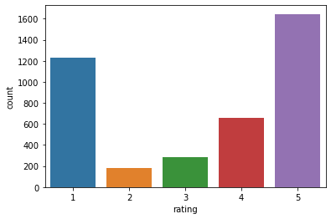
EDA STEPS and visualization -
a) Removing punctuation
b) Removing numbers
c) Converting text to lower case (no capital letters)
d) Removing extra whitespace
e) Removing stop-words (extremely common words which do not provide any analytic information and tend to be of little value i.e. a, and, are etc.)

Slide 6
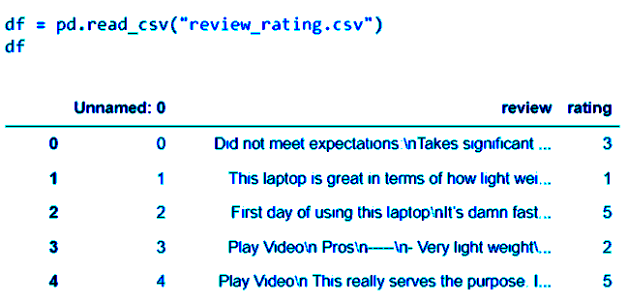
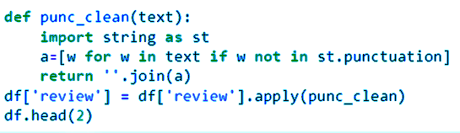
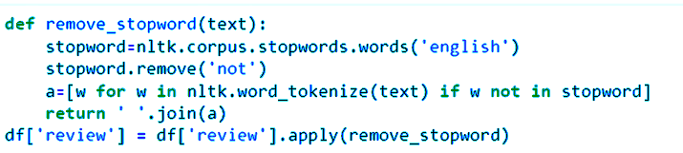
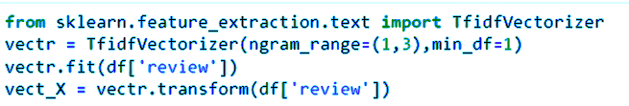

Slide 7
CONCLUSION :-
In this paper, we present a new RRP method that is based on the user context. More speciﬁcally, in order to solve problem of existing RRP methods based on review content, considering the user personalized information and product context information, which are useful to predict rating of review, we propose a RRP method based user context and product context. Experimental results on the datasets show that our proposed methods have more performance than the state-of-the-art baselines in RRP.

